Slide 1
ADC and DAC Programming in AVR

Slide 2
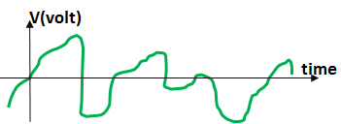

Analog vs. Digital Signals

Slide 3
DAC
Vout
4
3
2
V_{REF}
1
Step size =
0
input
Num of steps
00
01
10
11
V_{OUT} = num × step size
DAC
Binary number (input)
n
V_{OUT}
Vref

Slide 4
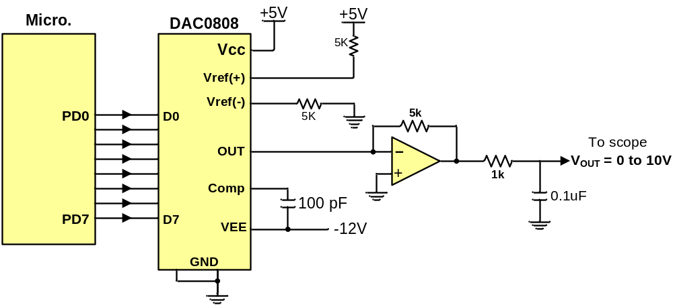
Connecting a DAC to the microcontroller

Slide 5
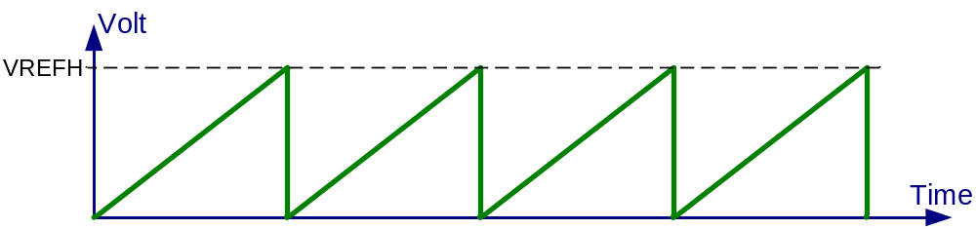
Generating a saw-tooth wave using DAC
#include <avr/io.h>
int main (void)
{
  unsigned char i = 0; //define a counter
  DDRD = 0xFF; //make Port D an output
  while (1) //do forever
  {
  PORTD = i;//copy i into PORTD to be converted
  i++;//increment the counter
  }
}

Slide 6
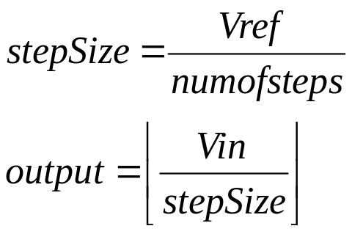
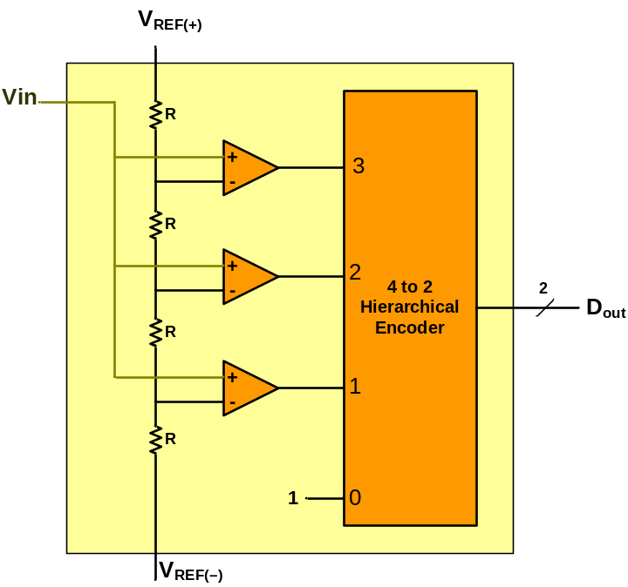
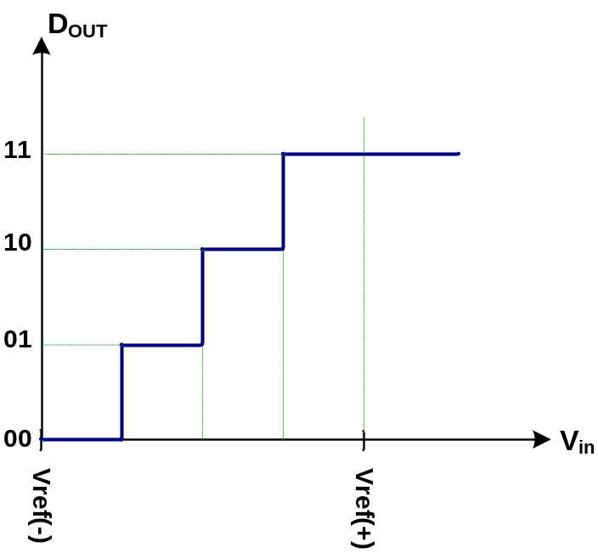
ADC
ADC
n
V_{in}
Output
(binary number)
Vref

Slide 7
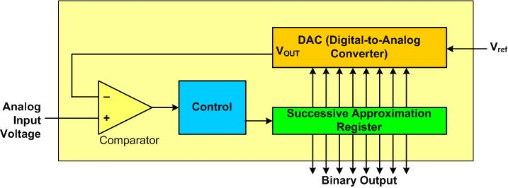
Successive Approximation ADC

Slide 8
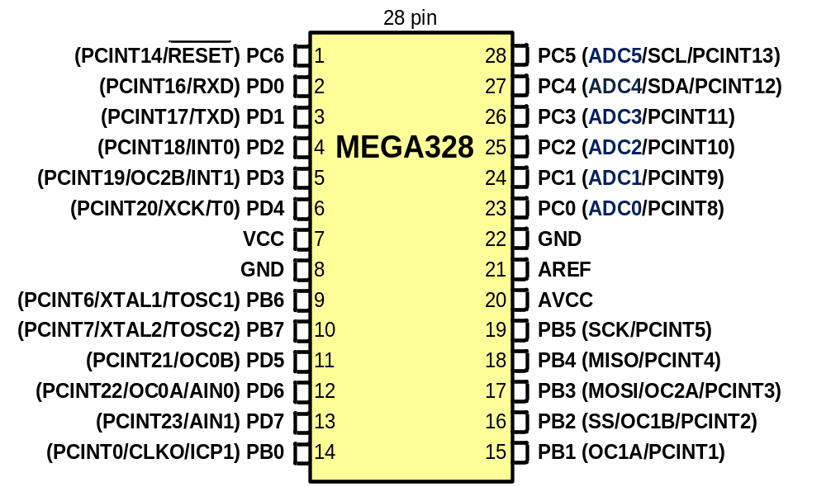
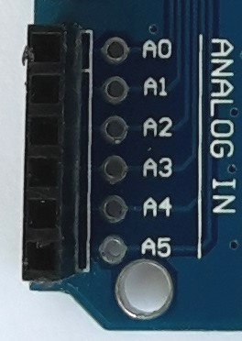
ADC in AVR

Slide 9
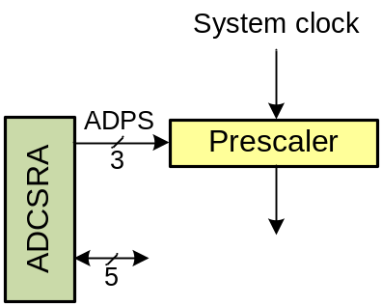
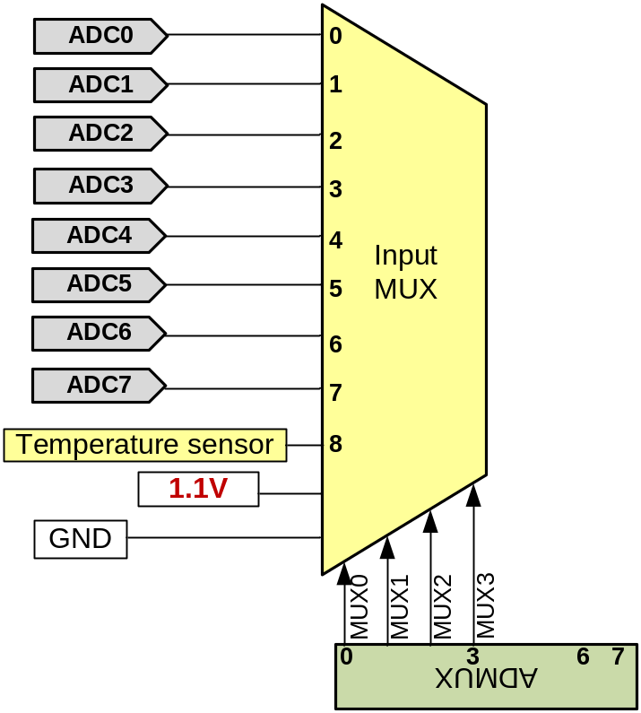
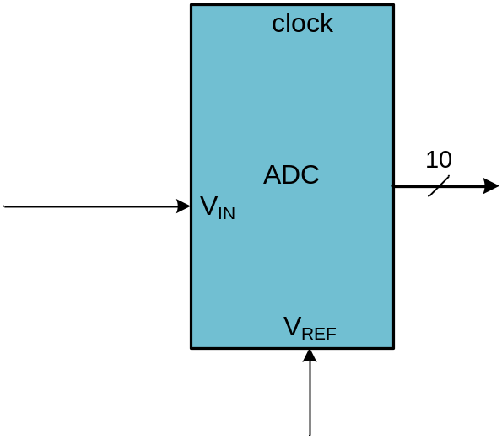

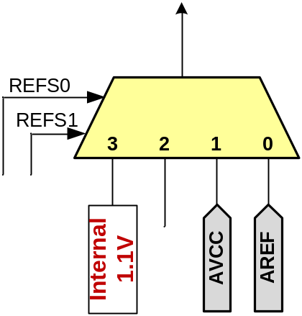
ADC in AVR

Slide 10
ADMUX
MUX0-MUX1: input select
ADLAR:
  0: right adjust the result
  1: left adjust the result
REFS1-REFS0: Vref selection
ADLAR = 0
ADLAR =1

Slide 11
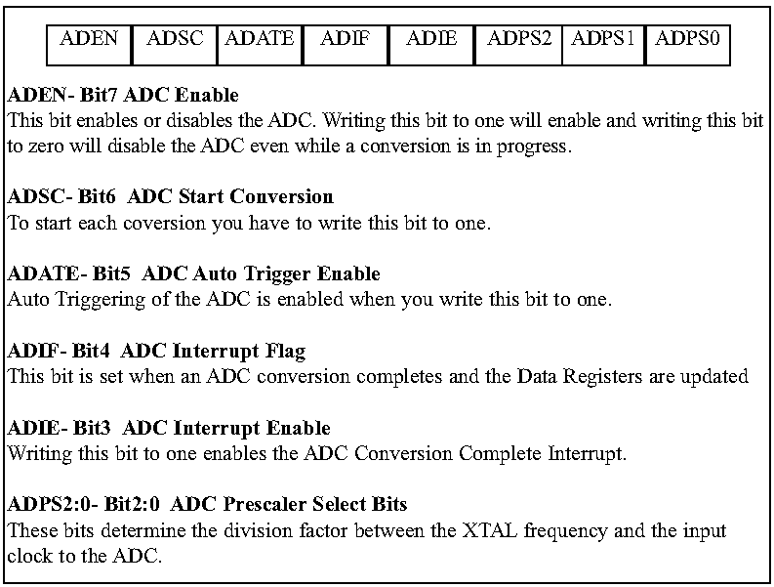
ADCSA

Slide 12
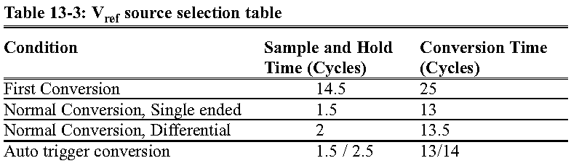
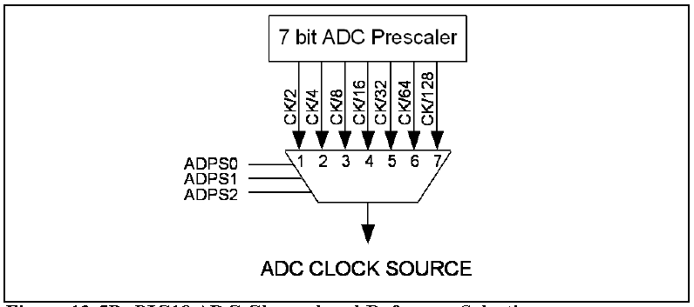
ADC Prescaler
PreScaler Bits let us change the clock frequency of ADC
The frequency of ADC should not be more than 200 KHz
Conversion time is longer in the first conversion

Slide 13
Steps in programming ADC
1. Make the pin for the selected ADC channel an input pin.
2. Turn on the ADC module
3. Select the conversion speed
4. Select voltage reference and ADC input channels.
5. Activate the start conversion bit by writing a one to the ADSC bit of ADCSRA.
6. Wait for the conversion to be completed by polling the ADIF bit in the ADCSRA register.
7. After the ADIF bit has gone HIGH, read the ADCL and ADCH registers to get the digital data output.
8. If you want to read the selected channel again, go back to step 5.
9. If you want to select another Vref source or input channel, go back to step 4.

Slide 14
A program with ADC
This program gets data from channel 0 (ADC0) of ;ADC and displays the result on Port B and Port D.
#include <avr/io.h>
#define F_CPU 16000000UL
#include <util/delay.h>
int main (void)
{
DDRB = 0xFF;//make Port B an output
DDRD = 0xFF; //make Port D an output
ADCSRA= 0x87;//make ADC enable and select ck/128
ADMUX= 0xC8;//1.1V Vref, temp. sensor, right-justified
while(1)
{
ADCSRA |= (1<<ADSC);//start conversion
while((ADCSRA&(1<<ADIF))==0);//wait for conversion to finish
ADCSRA |= (1<<ADIF);
PORTD = ADCL;//give the low byte to PORTD
PORTB = ADCH;//give the high byte to PORTB
_delay_ms(100);
}
}

Slide 15
Sensors
Sensor: Converts a physical signal (e.g. light, temperature, humidity, etc.) to an electrical signal (e.g. resistance, voltage, current, capacitance, etc)

Slide 16
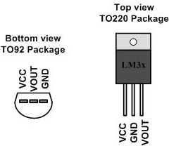
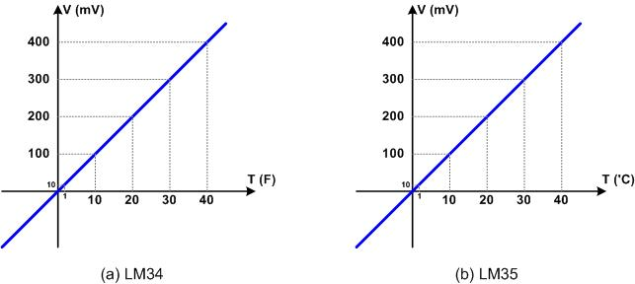
LM35 & LM34 (Temperature Sensors)
LM35 and LM34:
  convert temp. to voltage
  10mV for each degree

Slide 17
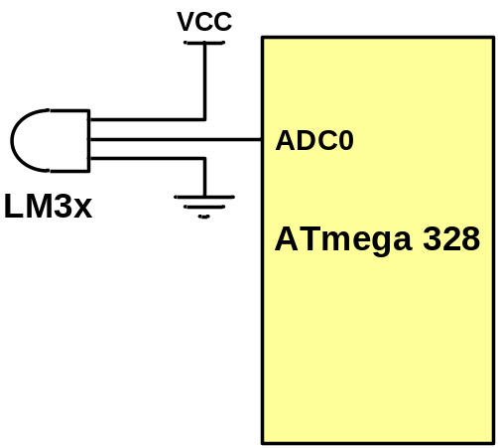
Using LM35
//this program reads the sensor and displays it on Port D
#include <avr/io.h> //standard AVR header
int main (void)
{
DDRB = 0xFF; //make Port B an output
DDRC = 0;//make Port C an input for ADC input
ADCSRA = 0x87;//make ADC enable and select ck/128
ADMUX = 0xC0;//1.1V Vref, ADC0, right-justified
while (1){
ADCSRA |= (1<<ADSC);//start conversion
while((ADCSRA&(1<<ADIF))==0); //wait for end of conversion
ADCSRA |= (1<<ADIF); //clear the ADIF flag
PORTB = (ADCL|(ADCH<<8))*10/93;//PORTB = adc value/9.3
}
}

Slide 18
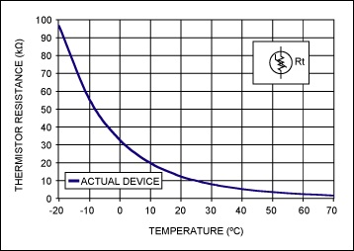
Thermistor (a temperature sensor)
Converts temperature to resistance
It is not linear

Slide 19
Signal conditioning
The output of some sensors (e.g. PT100) is in form of resistance
Some humidity sensor provide the result in form of Capacitance
We need to convert these signals to voltage, however, in order to send input to an ADC. This conversion is called signal conditioning.

